Slide 1
Database System Architectures

Slide 2
OUTLINE
Centralized Systems
Client–Server Systems
Transaction Server System
Data-server systems
Computer System Architecture
Parallel Processing Systems
Speedup
Scaleup
Distributed Database System
Multiprocessor systems vs DDBS
Promises of DDBSs
Complications Introduced by DDBS
What is being distributed in DDBS?
Classification of DDBMS
Data Fragmentations
Correctness Rules for Data Fragmentation
Distributed Database System Design Issues
Distributed DBMS Architecture
ANSI/SPARC Architecture
Peer-to-Peer Distributed Systems
Components of a Distributed DBMS
Multidatabase System (MDBS) Architecture
Component-based architectural model of a multi-DBMS

Slide 3
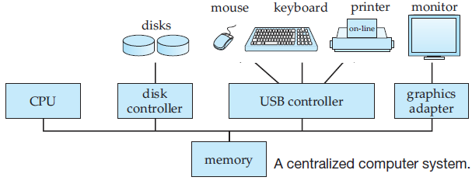
Database System Architectures
Centralized Systems
Centralized database systems are those that run on a single computer system and do not interact with other computer systems.

Slide 4
Database System Architectures
Centralized Systems
Single-user system is a desktop unit used by a single person, usually with only one processor and one or two hard disks, and usually only one person using the machine at a time. Personal computers and workstations fall into the first category.
Multiuser system has more disks and more memory, may have multiple CPUs and has a multiuser operating system. It serves a large number of users who are connected to the system via terminals.

Slide 5
Database System Architectures
Centralized Systems
These systems have coarse-granularity parallelism. Databases running on such machines usually do not attempt to partition a single query among the processors; instead, they run each query on a single processor, allowing multiple queries to run concurrently. Thus, such systems support a higher throughput; that is, they allow a greater number of transactions to run per second, although individual transactions do not run any faster.
Machines with fine-granularity parallelism have a large number of processors, and database systems running on such machines attempt to parallelize single tasks (queries, for example) submitted by users.

Slide 6
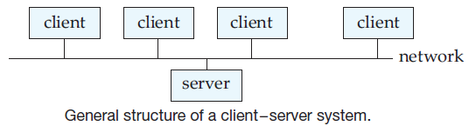
Database System Architectures
Client–Server Systems
Database functionality can be broadly divided into two parts:
Front end and
Back end.

Slide 7
Database System Architectures
Client–Server Systems
The back end manages access structures, query evaluation and optimization, concurrency control, and recovery.
The front end consists of tools such as forms, report writers, and graphical user interface facilities.
The interface between the front end and the back end is through SQL, or through an application program. Standards such as ODBC and JDBC, were developed to interface clients with servers.

Slide 8
Database System Architectures
Server System Architectures
Server systems can be broadly categorized as:
Transaction servers and
Data servers.
Transaction Server System
- Also called query-server systems provide an interface to which clients can send requests to perform an action, in response to which they execute the action and send back results to the client. Usually, client machines ship transactions to the server systems, where those transactions are executed, and results are shipped back to clients that are in charge of displaying the data.

Slide 9
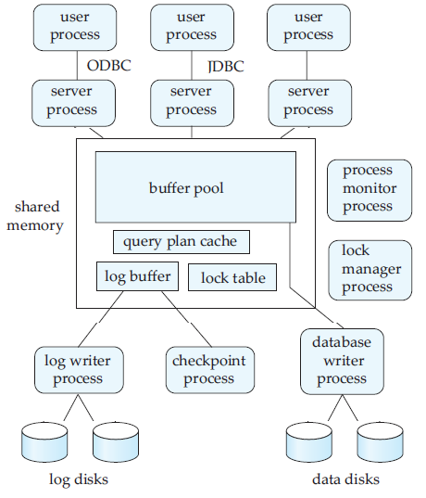
Database System Architectures
Transaction Server System
A typical transaction-server system today consists of multiple processes accessing data in shared memory.

Slide 10
Database System Architectures
Transaction Server System
Server processes: These are processes that receive user queries (transactions), execute them, and send the results back.
Lock manager process: This process implements lock manager functionality, which includes lock grant, lock release, and deadlock detection.
Database writer process: There are one or more processes that output modified buffer blocks back to disk on a continuous basis.

Slide 11
Database System Architectures
Transaction Server System
Log writer process: This process outputs log records from the log record buffer to stable storage.
Checkpoint process: This process performs periodic checkpoints. It consults log to determine those transactions that need to redone or undone.
Process monitor process: This process monitors other processes, and if any of them fails, it takes recovery actions for the process.

Slide 12
Database System Architectures
Data-server systems
- Allow clients to interact with the servers by making requests to read or update data, in units such as files or pages. Data server systems supply raw data to clients. Such systems strive to minimize communication between clients and servers by caching data and locks at the clients. Data servers for database systems offer much more functionality; they support units of data—such as pages, tuples, or objects —that are smaller than a file. They provide indexing facilities for data, and provide transaction facilities so that the data are never left in an inconsistent state if a client machine or process fails. Data-server systems are used in local-area networks, where there is a high-speed connection between the clients and the server.

Slide 13
Database System Architectures
Computer System Architecture
Computer system architectures consisting of interconnected multiple processors are basically classified into two different categories:
Tightly coupled system and
Loosely coupled system.

Slide 14
Database System Architectures
Tightly Coupled System
There is a single system wide global primary memory that is shared by processors connected to the system. If any processor writes some information in the global memory, it can be shared by all other processors. For example, if a processor writes the value 200 to a memory location y, any other processors reading from the location y will get the value 200. In this system, communication takes place through shared memory.
System wide shared global memory
CPU ₁
CPU₂
CPU₃
CPU₄
Communication Network
Fig. A Tightly coupled multiprocessor system
Also called parallel processing system.

Slide 15
Database System Architectures
Loosely Coupled System
Processors don’t share memory. Each processor has its own local memory. If a processor writes a value 200 to a memory location y, it only changes the content of its own local memory and does not affect the content of the memory of any other processors. In this system, communications are established by passing messages across the network.
Local memory
Local memory
Local memory
CPU₁
CPU₂
CPU_{n}
Communication Network
Fig. A Loosely coupled multiprocessor system
Also called distributed system.

Slide 16
Database System Architectures
Parallel Processing Systems
A parallel processing system involves multiple processes that are active simultaneously and solving a given problem, generally on multiple processors. It divides a large task into several subtasks and executes these subtasks concurrently on several processors.
Characteristics
Parallel systems improve processing and I/O speeds by using multiple CPUs and disks in parallel.
All processors in the system can perform their tasks concurrently.
Tasks need to be synchronized.
Processors usually share resources such as data, disks, and other devices.
Parallel computers with hundreds of CPUs and disks are available commercially.
Parallel system improves the system performance in terms of two important properties: Speedup and Scaleup.

Slide 17
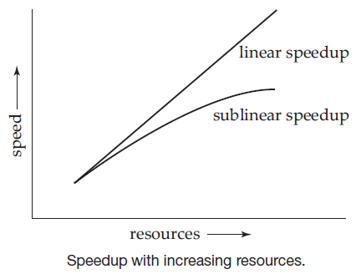
Database System Architectures
Speedup
Running a given task in less time by increasing the degree of parallelism is called speedup.
Suppose that the execution time of a task on a larger machine is T_{L.} The execution time of the same task on a smaller machine is T_{S}. Thus, Speedup = T_{S}/T_{L}.
If the speedup is N when the larger system has N times the resources (processors, disk, and so on) of the smaller system, the system is said to demonstrate linear speedup. If the speedup is less than N, the system is said to demonstrate sublinear speedup.

Slide 18
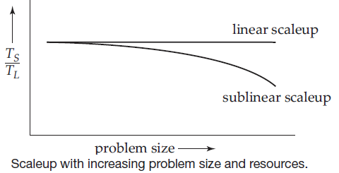
Database System Architectures
Scaleup
Handling larger tasks by increasing the degree of parallelism is called scaleup.
Let Q be a task, and let Q_{N} be another task that is N times bigger than Q. Suppose the execution time of task Q on a smaller machine M_{S} is T_{S}, and the execution time of task Q_{N} on a parallel machine M_{L} is T_{L}. Thus, scaleup = T_{S}/T_{L}
The parallel system M_{L} is said to demonstrate linear scaleup on task Q if T_{L} = T_{S}. If T_{L} > T_{S}, the system is said to demonstrate sublinear scaleup

Slide 19
Database System Architectures
What is a Distributed Database System?
We define a distributed database as a collection of multiple, logically interrelated databases distributed over a computer network. A distributed database management system (distributed DBMS) is then defined as the software system that permits the management of the distributed database and makes the distribution transparent to the users.
A DDBS is not a “collection of files” that can be individually stored at each node of a computer network. To form a DDBS, files should not only be logically related, but there should be structured among the files, and access should be via a common interface.

Slide 20
Database System Architectures
Multiprocessor systems VS DDBS ?
Multiprocessor systems are not considered as DDBSs.
In DDBS, the communication between nodes is done over a network instead of through shared memory or shared disk, with the network as the only shared resource.
Although shared-nothing multiprocessors, where each processor node has its own primary and secondary memory, and may also have its own peripherals, are quite similar to the distributed environment, there are differences.

Slide 21
Database System Architectures
Multiprocessor systems VS DDBS ?
A multiprocessor system design is symmetrical, consisting of a number of identical processor and memory components, and controlled by one or more copies of the same operating system that is responsible for a strict control of the task assignment to each processor. This is not true in distributed computing systems, where heterogeneity of the operating system as well as the hardware is quite common.
Database systems that run over multiprocessor systems are called parallel database systems.

Slide 22
Database System Architectures
What is Distributed Data Processing or distributed computing system?
A distributed computing system states that it is a number of autonomous processing elements (not necessarily homogeneous) that are interconnected by a computer network and that cooperate in performing their assigned tasks.

Slide 23
Database System Architectures
Distributed Database Management System
Consists of a single logical database that is split into a number of fragments. Each fragment is stored on one or more computers.
The computers in a distributed system communicate with one another through various communication media, such as high-speed networks or telephone lines.
They do not share main memory or disks.
Each site is capable of independently processing user requests that require access to local data as well as it is capable of processing user requests that require access to remote data stored on other computers in the network.
The general structure of a distributed system appears in the following figure.

Slide 24
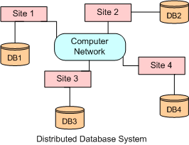
Database System Architectures
Distributed Database Management System
The general structure of a distributed system appears in the following figure.

Slide 25
Database System Architectures
Distributed Database Management System
A local transaction is one that accesses data only from sites where the transaction was initiated.
A global transaction, on the other hand, is one that either accesses data in a site different from the one at which the transaction was initiated, or accesses data in several different sites.

Slide 26
Database System Architectures
Promises of DDBSs
Many advantages of DDBSs have been cited in literature, ranging from sociological reasons for decentralization to better economics. All of these can be distilled to four fundamentals which may also be viewed as promises of DDBS technology:
Transparent management of distributed and replicated data.
Reliable access to data through distributed transactions
Improved performance and
Easier system expansion.

Slide 27
Database System Architectures
Promises of DDBSs
Transparent Management of Distributed and Replicated Data
Transparency refers to separation of the higher-level semantics of a system from lower-level implementation issues.
In other words, a transparent system “hides” the implementation details from users.
The advantage of a fully transparent DBMS is the high level of support that it provides for the development of complex applications.

Slide 28
Database System Architectures
Promises of DDBSs
Reliability through Distributed Transactions
Distributed DBMSs are intended to improve reliability since they have replicated components and, thereby eliminate single points of failure.
The failure of a single site, or the failure of a communication link which makes one or more sites unreachable, is not sufficient to bring down the entire system.

Slide 29
Database System Architectures
Promises of DDBSs: Improved Performance
A distributed DBMS fragments the conceptual database, enabling data to be stored in close proximity to its points of use (also called data localization). This has two potential advantages:
Since each site handles only a portion of the database, contention for CPU and I/O services is not as severe as for centralized databases.
Localization reduces remote access delays.
Inter-query parallelism results from the ability to execute multiple queries at the same time while intra-query parallelism is achieved by breaking up a single query into a number of subqueries each of which is executed at a different site, accessing a different part of the distributed database.

Slide 30
Database System Architectures
Promises of DDBSs:
Easier System Expansion
In a distributed environment, it is much easier to accommodate increasing database sizes.
Expansion can usually be handled by adding processing and storage power to the network.
Obviously, it may not be possible to obtain a linear increase in “power,” since this also depends on the overhead of distribution.

Slide 31
Database System Architectures
Complications Introduced by DDBS
Data may be replicated in a distributed environment. A distributed database can be designed so that the entire database, or portions of it, reside at different sites of a computer network.
If some sites fail or if some communication links fail while an update is being executed, the system must make sure that the effects will be reflected on the data residing at the failing or unreachable sites as soon as the system can recover from the failure.
The exchange of messages and the additional computation required to achieve inter-site coordination are a form of overhead that does not arise in centralized systems.

Slide 32
Database System Architectures
Complications Introduced by DDBS
4. As data in a distributed DBMS are located at multiple sites, the probability of security lapses increases. Further, all communications between different sites in a distributed DBMS are conveyed through the network, so the underlying network has to be made secure to maintain system security.
5. Since each site cannot have instantaneous information on the actions currently being carried out at the other sites, the synchronization of transactions on multiple sites is considerably harder than for a centralized system.

Slide 33
Database System Architectures
What is being distributed in DDBS?
Processing logic or processing elements are distributed. The “processing element” is a computing device that can execute a program on its own.
Function. Various functions of a computer system could be delegated to various pieces of hardware or software.
Data. Data used by a number of applications may be distributed to a number of processing sites.
Finally, control can be distributed. The control of the execution of various tasks might be distributed instead of being performed by one computer system.

Slide 34
Database System Architectures
Classification of DDBMS
Homogeneous and
Heterogeneous Databases
Homogeneous Distributed Database
All sites have identical database management system software, are aware of one another, and agree to cooperate in processing users’ requests.
Use same DB schemas at all sites.
Easier to design and manage
Addition of a new site is much easier.

Slide 35
Database System Architectures
Heterogeneous distributed database
Usually constructed over a no. of existing sites.
Each site has its local database. Different sites may use different schemas (relational model, OO model etc.).
Use different DBMS software.
Query processing is more difficult.
Use gateways (as query translator) which convert the language and data model of each different DBMS into the language and data model of the relational system.

Slide 36
Database System Architectures
Data Storage in DDBMS
Replication. The system maintains several identical replicas (copies) of the relation, and stores each replica at a different site.
Fragmentation. The system partitions the relation into several fragments, and stores each fragment at a different site.
Fragmentation and replication can be combined.
Advantages and disadvantages of Replication
Availability.
Increased parallelism.
Increased overhead on update.

Slide 37
Database System Architectures
Data Fragmentation
If relation r is fragmented, r is divided into a number of fragments r₁, r₂, . . . , r_{n}.
These fragments contain sufficient information to allow reconstruction of the original relation r.
There are two different schemes for fragmenting a relation:
- Horizontal fragmentation and
- Vertical fragmentation

Slide 38
Database System Architectures
Horizontal Fragmentation
In horizontal fragmentation, a relation r is partitioned into a number of subsets, r₁, r₂, . . . , r_{n}.
Each tuple of relation r must belong to at least one of the fragments, so that the original relation can be reconstructed, if needed.
As an illustration, consider the account relation:
Account-schema = (account-number, branch-name, balance)
The relation can be divided into several different fragments. If the banking system has only two branches - Savar and Dhanmondi - then there are two different fragments:
account₁ = σ_{branch-name = “Savar”} (account)
account₂ = σ_{branch-name = “Dhanmondi”} (account)

Slide 39
Database System Architectures
Horizontal Fragmentation
Use a predicate P_{i} to construct fragment r_{i}:
r_{i} = σ_{Pi} (r)
Reconstruct the relation r by taking the union of all fragments. That is,
r = r₁ ∪ r₂ ∪ · · · ∪ r_{n}
The fragments are disjoint.

Slide 40
Database System Architectures
Vertical Fragmentation
Vertical fragmentation of r(R) involves the definition of several subsets of attributes R₁, R₂, . . .,R_{n} of the schema R so that
R = R₁ ∪ R₂ ∪ · · · ∪ R_{n}
Each fragment r_{i} of r is defined by
r_{i} = Π_{Ri} (r)
We can reconstruct relation r from the fragments by taking the natural join
r = r₁ ⋈ r₂ ⋈ r₃ ⋈ · · · ⋈ r_{n}
One way of ensuring that the relation r can be reconstructed is to include the primary-key attributes of R in each of the R_{i}.

Slide 41
Database System Architectures
Vertical Fragmentation
- To illustrate vertical fragmentation, consider the following relation:
employee-info=(employee-id, name, designation, salary)
- For privacy reasons, the relation may be fragmented into a relation employee-privateinfo containing employee-id and salary, and another relation employee-public-info containing attributes employee-id, name, and designation.
employee-privateinfo=(employee-id, salary)
employee-publicinfo=(employee-id, name, designation)
These may be stored at different sites, again for security reasons.

Slide 42
Database System Architectures
Correctness Rules for Data Fragmentation
To ensure no loss of information and no redundancy of data, there are three different rules that must be considered during fragmentation.
Completeness
If a relation instance R is decomposed into fragments R₁, R₂, . . . .R_{n}, each data item in R must appear in at least one of the fragments. It is necessary in fragmentation to ensure that there is no loss of data during data fragmentation.
Reconstruction
If relation R is decomposed into fragments R₁, R₂, . . . .R_{n}, it must be possible to define a relational operation that will reconstruct the relation R from fragments R₁, R₂, . . . .R_{n}. This rule ensures that constrains defined on the data are preserved during data fragmentation.

Slide 43
Database System Architectures
Correctness Rules for Data Fragmentation
To ensure no loss of information and no redundancy of data, there are three different rules that must be considered during fragmentation.
Disjointness
If a relation R is decomposed into fragments R₁, R₂, . . . .R_{n} and if a data item is found in the fragment R_{i}, then it must not appear in any other fragments. This rule ensures minimal data redundancy.
In case of vertical fragmentation, primary key attribute must be repeated to allow reconstruction. Therefore, in case of vertical fragmentation, disjointness is defined only on non-primary key attributes of a relation.

Slide 44
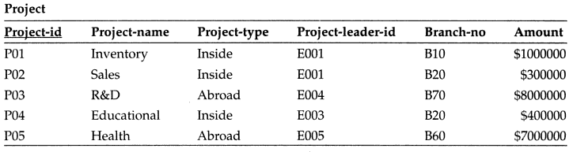
Database System Architectures
Example
Let us consider the relational schema Project where project-type represents whether the project is an inside project or abroad project. Assume that P1 and P2 are two horizontal fragments of the relation Project, which are obtained by using the predicate “whether the value of project-type attribute is ‘inside’ or ‘abroad’.

Slide 45
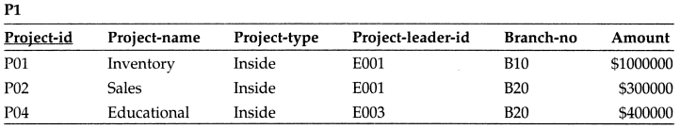
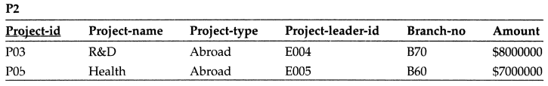
Database System Architectures
Example (Horizontal Fragmentation)
P1: σ_{project-type = “inside”} (Project)
P2: σ_{project-type = “abroad”} (Project)

Slide 46
Database System Architectures
Example (Horizontal Fragmentation)
These horizontal fragments satisfy all the correctness rules of fragmentation as shown below.
Completeness: Each tuple in the relation Project appears either in fragment P1 or P2. Thus, it satisfies completeness rule for fragmentation.
Reconstruction: The Project relation can be reconstructed from the horizontal fragments P1 and P2 by using the union operation of relational algebra, which ensures the reconstruction rule.
Thus, P1 P2 = Project.
Disjointness: The fragments P1 and P2 are disjoint, since there can be no such project whose project type is both “inside” and “abroad”.

Slide 47
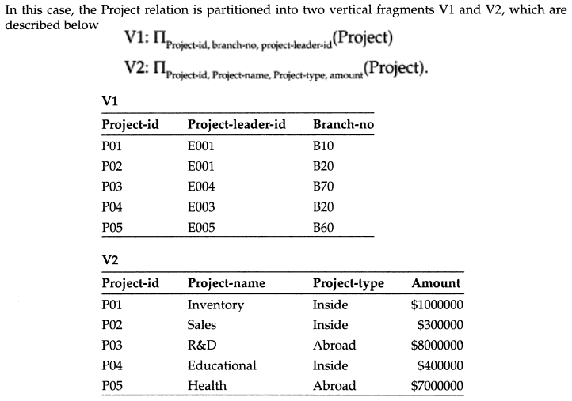
Database System Architectures
Example (Vertical Fragmentation)

Slide 48
Database System Architectures
Example (Vertical Fragmentation)
These vertical fragments also ensure the correctness rules of fragmentation as shown below.
Completeness: Each tuple in the relation Project appears either in fragment V1 or V2 which satisfies completeness rule for fragmentation.
Reconstruction: The Project relation can be reconstructed from the vertical fragments V1 and V2 by using the natural join operation of relational algebra, which ensures the reconstruction rule.
Thus, V1 ⋈ V2 = Project.
Disjointness: The fragments V1 and V2 are disjoint, except for the primary key project-id, which is repeated in both fragments and is necessary for reconstruction.

Slide 49
Database System Architectures
Distributed Database System Design Issues
Distributed Database Design
Distributed Directory Management
Distributed Query Processing
Distributed Concurrency Control
Distributed Deadlock Management
Reliability of Distributed DBMS
Replication
Relationship among Problems

Slide 50
Database System Architectures
Distributed Database Design
There are two basic alternatives to placing data:
Partitioned (or non-replicated) and
Replicated
In the partitioned scheme the database is divided into a number of disjoint partitions each of which is placed at a different site.
Replicated designs can be either fully replicated (also called fully duplicated) where the entire database is stored at each site, or partially replicated (or partially duplicated) where each partition of the database is stored at more than one site, but not at all the sites.

Slide 51
Database System Architectures
Distributed Directory Management
A directory contains information (such as descriptions and locations) about data items in the database.
A directory may be global to the entire DDBS or local to each site;
It can be centralized at one site or distributed over several sites; there can be a single copy or multiple copies.

Slide 52
Database System Architectures
Distributed Query Processing
Query processing deals with designing algorithms that analyze queries and convert them into a series of data manipulation operations.
The problem is how to decide on a strategy for executing each query over the network in the most cost-effective way.
The factors to be considered are the distribution of data, communication costs, and lack of sufficient locally-available information.

Slide 53
Database System Architectures
Distributed Concurrency Control
Concurrency control involves the synchronization of accesses to the distributed database, such that the integrity of the database is maintained.
Distributed Deadlock Management
The competition among users for access to a set of resources (data, in this case) can result in a deadlock if the synchronization mechanism is based on locking.
The well-known alternatives of prevention, avoidance, and detection/recovery also apply to DDBSs.

Slide 54
Database System Architectures
Reliability of Distributed DBMS
One of the potential advantages of distributed systems is improved reliability and availability. This, however, is not a feature that comes automatically.
It is important that mechanisms be provided to ensure the consistency of the database as well as to detect failures and recover from them.
When a failure occurs and various sites become either inoperable or inaccessible, the databases at the operational sites remain consistent and up to date.

Slide 55
Database System Architectures
Replication
If the distributed database is (partially or fully) replicated, it is necessary to implement protocols that ensure the consistency of the replicas,
Relationship among Problems
The problems are not isolated from one another. Each problem is affected by the solutions found for the others.
The relationship among the components is shown in the following Figure. The design of distributed databases affects many areas. It affects directory management, because the definition of fragments and their placement determine the contents of the directory as well as the strategies that may be employed to manage them.

Slide 56
Database System Architectures
Relationship among Problems
Directory Management
Query Processing
Distributed DB Design
Reliability
Replication
Concurrency Control
Deadlock Management
Fig.: Relationship among Research Issues

Slide 57
Database System Architectures
Relationship among Problems
The same information (i.e., fragment structure and placement) is used by the query processor to determine the query evaluation strategy. Similarly, directory placement and contents influence the processing of queries.
The replication of fragments when they are distributed affects the concurrency control strategies that might be employed.
Some concurrency control algorithms cannot be easily used with replicated databases.

Slide 58
Database System Architectures
Relationship among Problems
There is a strong relationship among the concurrency control problem, the deadlock management problem, and reliability issues. The concurrency control algorithm that is employed will determine whether or not a separate deadlock management facility is required. If a locking-based algorithm is used, deadlocks will occur, whereas they will not if timestamping is the chosen alternative.
Reliability mechanisms involve both local recovery techniques and distributed reliability protocols. Techniques to provide reliability also make use of data placement information since the existence of duplicate copies of the data serve as a safeguard to maintain reliable operation.

Slide 59
Database System Architectures
Relationship among Problems
Finally, the need for replication protocols arise if data distribution involves replicas.

Slide 60
Database System Architectures
Distributed Database System
Each site has autonomous processing capability and can perform local applications.
Each site also participates in the execution of at least one global application which requires accessing data at several sites.

Slide 61
Database System Architectures
Distributed DBMS Architecture
The architecture of a system defines its structure. This means that the components of the system are identified, the function of each component is specified, and the interrelationships and interactions among these components are defined.
Three reference architectures for a distributed DBMS:
Client/Server systems
Peer-to-Peer distributed DBMS and
Multidatabase systems.
A reference architecture is commonly created by standards developers to clearly define the interfaces that need to be standardized.

Slide 62
Database System Architectures
ANSI/SPARC Architecture
A simplified version of the ANSI/SPARC architecture is depicted in the following Figure.
There are three views of data:
External view, which is that of the end user,
Internal view, that of the system or machine
Conceptual view, that of the enterprise. For each of these views, an appropriate schema definition is required.

Slide 63
Database System Architectures
ANSI/SPARC Architecture
Users
External Schema
External View
External View
External View
Conceptual Schema
Conceptual View
Internal View
Internal Schema
Fig.: The ANSI/SPARC Architecture

Slide 64
Database System Architectures
ANSI/SPARC Architecture
At the lowest level of the architecture is the internal view, which deals with the physical definition and organization of data. The location of data on different storage devices and the access mechanisms used to reach and manipulate data are the issues dealt with at this level.
At the other extreme is the external view, which is concerned with how users view the database. An individual user’s view represents the portion of the database that will be accessed by that user. A view can be shared among a number of users, with the collection of user views making up the external schema.

Slide 65
Database System Architectures
ANSI/SPARC Architecture
In between these two ends is the conceptual schema, which is an abstract definition of the database.
American National Standards Institute (ANSI) established a Study Group on Database Management Systems under the auspices of its Standards Planning and Requirements Committee (SPARC).

Slide 66
Database System Architectures
Distributed DBMS Architecture
The client/server distribution concentrates data management duties at servers while the clients focus on providing the application environment including the user interface.
In peer-to-peer distribution, there is no distinction of client machines versus servers. Each machine has full DBMS functionality and can communicate with other machines to execute queries and transactions.

Slide 67
Database System Architectures
Peer-to-Peer Distributed Systems
The physical data organization on each machine is different. There needs to be an individual internal schema definition at each site (Local Internal Schema (LIS)).
The enterprise view of the data is described by the Global Conceptual Schema (GCS)- it describes the logical structure of the data at all the sites.
Data in a distributed database is usually fragmented and replicated.

Slide 68
Database System Architectures
Peer-to-Peer Distributed Systems
To handle fragmentation and replication, the logical organization of data at each site needs to be described. Therefore, there needs to be a third layer in the architecture, the Local Conceptual Schema (LCS).
The GCS is the union of the LCSs. User applications and user access to the database is supported by External Schemas (ESs)

Slide 69
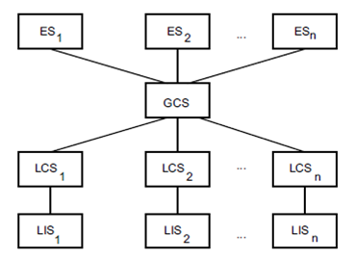
Database System Architectures
Peer-to-Peer Distributed Systems
Fig.: Distributed Database Reference Architecture

Slide 70
Database System Architectures
Peer-to-Peer Distributed Systems
The distributed DBMS translates global queries into a group of local queries, which are executed by distributed DBMS components at different sites that communicate one another.

Slide 71
Database System Architectures
Components of a Distributed DBMS
Major two components:
User Processor:
Handles the interaction with users and
Data Processor:
Deals with the storage.

Slide 72
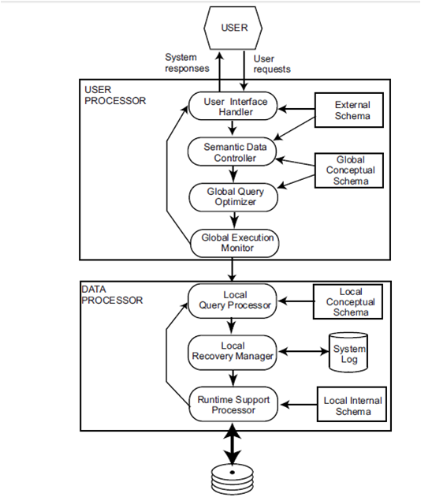
Database System Architectures
Components of a Distributed DBMS

Slide 73
Database System Architectures
Components of a Distributed DBMS
The first component User Processor consists of four elements:
i) User interface handler
ii) Semantic data controller
iii) Global query optimizer and decomposer
iv) Distributed execution monitor
The user interface handler is responsible for interpreting user commands as they come in, and formatting the result data as it is sent to the user.
The semantic data controller uses the integrity constraints and authorizations that are defined as part of the global conceptual schema to check if the user query can be processed.

Slide 74
Database System Architectures
Components of a Distributed DBMS
3. The global query optimizer and decomposer determines an execution strategy to minimize a cost function, and translates the global queries into local ones using the global and local conceptual schemas. The global query optimizer is responsible, among other things, for generating the best strategy to execute distributed join operations.
4. The distributed execution monitor coordinates the distributed execution of the user request. The execution monitor is also called the distributed transaction manager. In executing queries in a distributed fashion, the execution monitors at various sites may, and usually do, communicate with one another.

Slide 75
Database System Architectures
Components of a Distributed DBMS
The second component Data Processor consists of three elements:
i) Local query optimizer
ii) Local recovery manager
iii) Run-time support processor
In peer-to-peer systems, one expects to find both the user processor modules and the data processor modules on each machine.
1. The local query optimizer, which actually acts as the access path selector, is responsible for choosing the best access path to access any data item.

Slide 76
Database System Architectures
Components of a Distributed DBMS
The local recovery manager is responsible for making sure that the local database remains consistent even when failures occur.
The run-time support processor physically accesses the database according to the physical commands in the schedule generated by the query optimizer. The run-time support processor is the interface to the operating system and contains the database buffer (or cache) manager, which is responsible for maintaining the main memory buffers and managing the data accesses.

Slide 77
Database System Architectures
Multidatabase System (MDBS) Architecture
Multidatabase systems (MDBS) represent the case where individual DBMSs (whether distributed or not) are fully autonomous and have no concept of cooperation;
They may not even “know” of each other’s existence or how to talk to each other.

Slide 78
Database System Architectures
Distributed multi-DBMSs VS distributed DBMSs
The fundamental difference relates to the definition of the global conceptual schema. In the case of logically integrated distributed DBMSs, the global conceptual schema defines the conceptual view of the entire database, while in the case of distributed multi-DBMSs, it represents only the collection of some of the local databases that each local DBMS wants to share.
The individual DBMSs may choose to make some of their data available for access by others by defining an export schema.

Slide 79
Database System Architectures
Distributed multi-DBMSs VS distributed DBMSs
In MDBSs, the global database is equal to the union of local databases, whereas in distributed DBMSs it is only a subset of the same union.
In a MDBS, the GCS is defined by integrating either the external schemas of local autonomous databases or local conceptual schemas.

Slide 80
Database System Architectures
MDBS Architecture
GES₁
GES₂
GES₃
GCS
LES₁₁
LES₁₂
LES₁₃
LES_{n1}
LES_{n2}
LES_{n3}
LCS₁
. . . .
LCS_{n}
LIS₁
. . . .
LIS_{n}
Fig.: MDBS Architecture with a GCS

Slide 81
Database System Architectures
MDBS Architecture
Users of a local DBMS define their own views on the local database and do not need to change their applications if they do not want to access data from another database. This is again an issue of autonomy.
Designing the global conceptual schema in multidatabase systems involves the integration of either the local conceptual schemas or the local external schemas.
Once the GCS has been designed, views over the global schema can be defined for users who require global access. It is not necessary for the GES and GCS to be defined using the same data model and language; whether they do or not determines whether the system is homogeneous or heterogeneous.

Slide 82
Database System Architectures
MDBS Architecture
LIS Local Internal Schema: Physical data organization and techniques to manipulate data at different sites.
LCS Local Conceptual Schema: data definition at different sites.
LES Local External Schema: Local user data view.
GCS Global Conceptual Schema: Union of LCSs who want to share data. Data definition for global users.
GES Global External Schema: Global user data view.

Slide 83
Database System Architectures
Component-based architectural model of a multi-DBMS
User
System responses
User
requests
Multi-DBMS Layer
. . . .
DBMS
DBMS
Fig.: Components of an MDBS

Slide 84
Database System Architectures
Component-based architectural model of a multi-DBS
MDBS provides a layer of software that runs on top of these individual DBMSs and provides users with the facilities of accessing various databases.
In a distributed MDBS, the multi-DBMS layer may run on multiple sites or there may be central site where those services are offered.
The MDBS layer is simply another application that submits requests and receives answers.

Slide 85
Database System Architectures
Thanks

